Slide 1
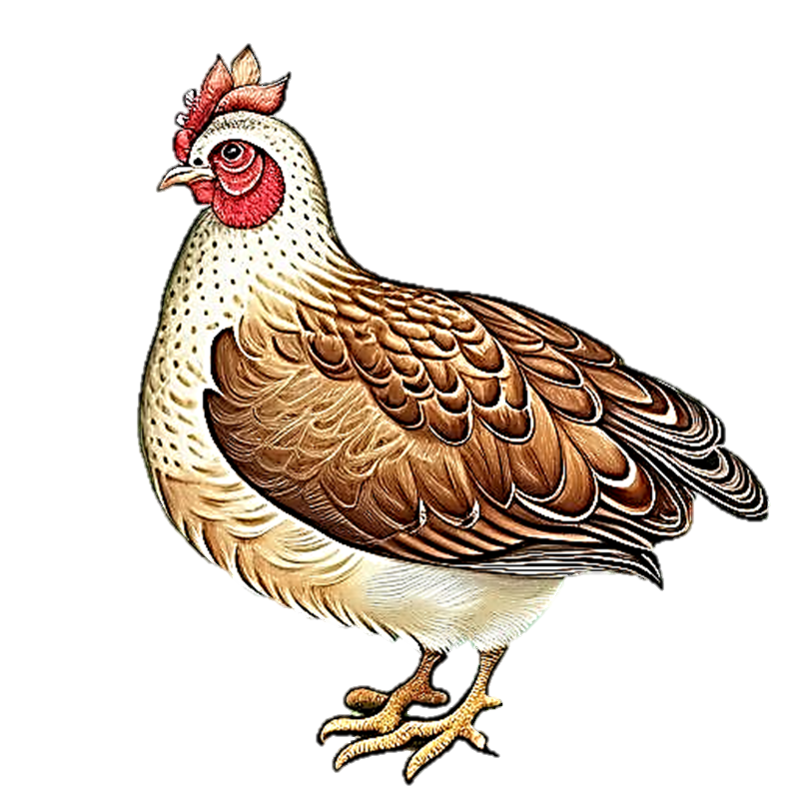

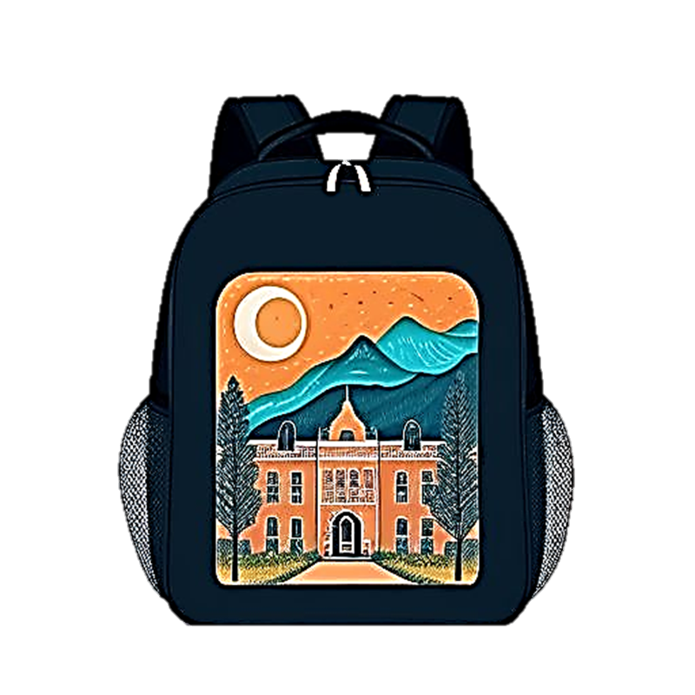
Vowel Consonant
Workbook
H
g
B
A
a
B
b
C
c
D
d
E
e
F
f
G
g
H
h
I
i
J
j
K
k
L
l
M
m
N
n
O
o
P
p
Q
q
R
r
S
s
T
t
U
u
V
v
W
w
X
x
Y
y
Z
z

Slide 2
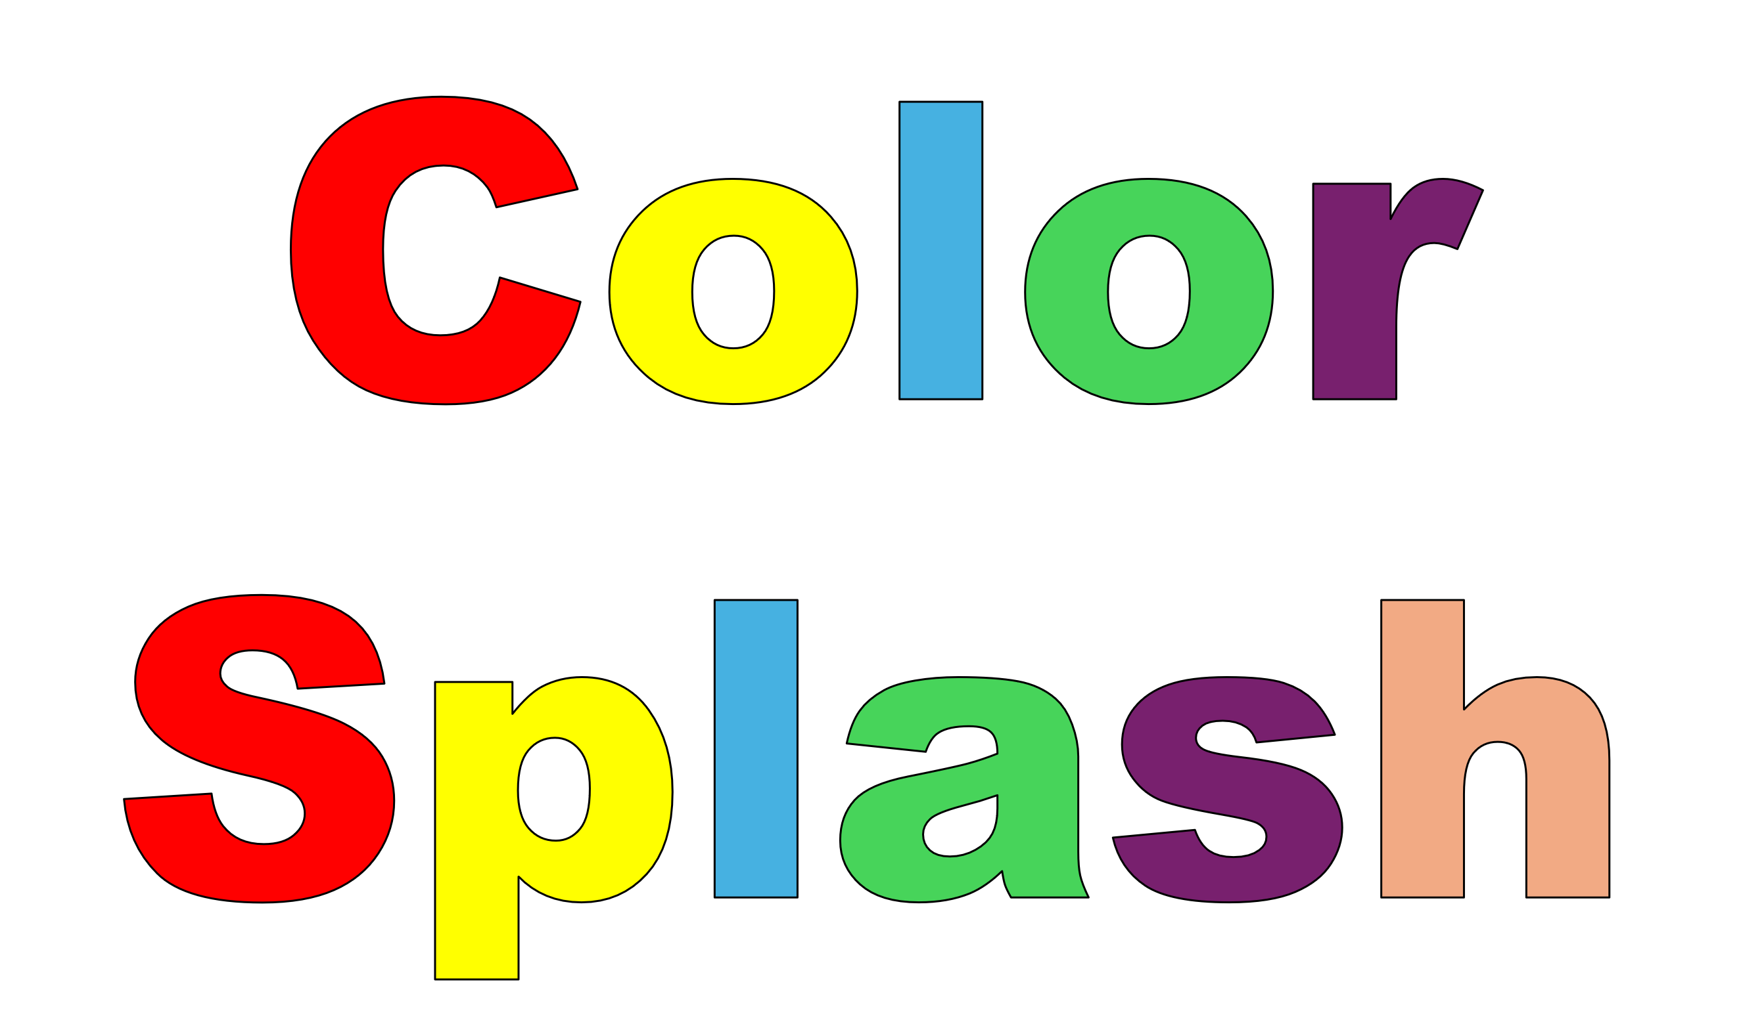

Vowel-Consonant
Blossomings.github.io
P
B
Color Splash
A
a
B
b
C
c
D
d
E
e
F
f
G
g
H
h
I
i
J
j
K
k
L
l
M
m
N
n
O
o
P
p
Q
q
R
r
S
s
T
t
U
u
V
v
W
w
X
x
Y
y
Z
z

Slide 3

Vowel-Consonant
Blossomings.github.io
g
t
Color Splash
A
a
B
b
C
c
D
d
E
e
F
f
G
g
H
h
I
i
J
j
K
k
L
l
M
m
N
n
O
o
P
p
Q
q
R
r
S
s
T
t
U
u
V
v
W
w
X
x
Y
y
Z
z

Slide 4


Vowel-Consonant
Blossomings.github.io
D
B
Color Splash
A
a
B
b
C
c
D
d
E
e
F
f
G
g
H
h
I
i
J
j
K
k
L
l
M
m
N
n
O
o
P
p
Q
q
R
r
S
s
T
t
U
u
V
v
W
w
X
x
Y
y
Z
z

Slide 5

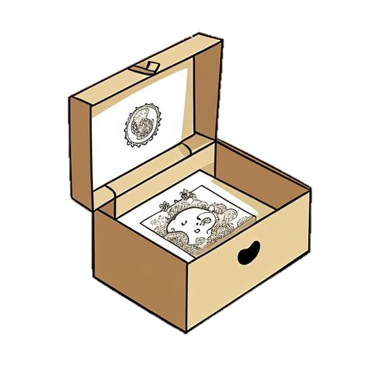
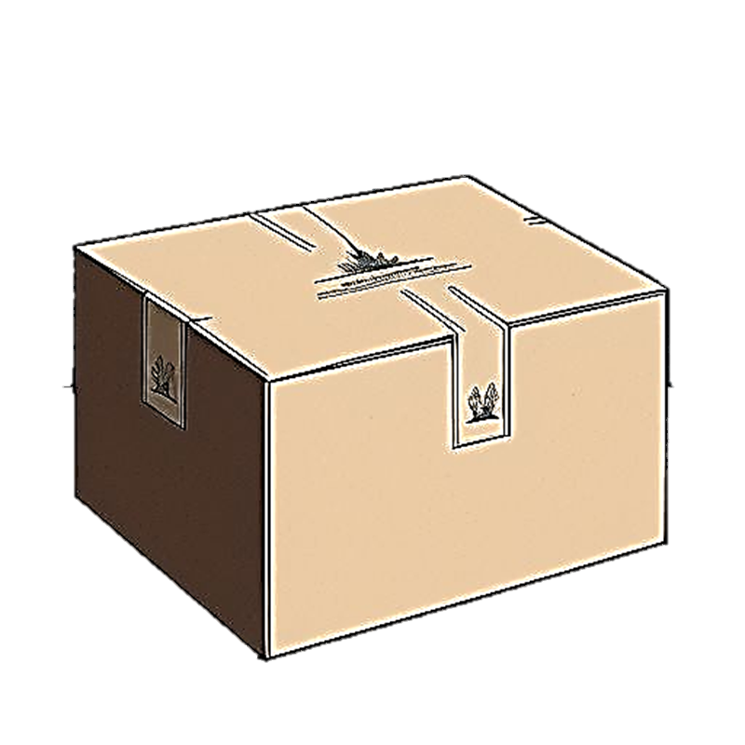


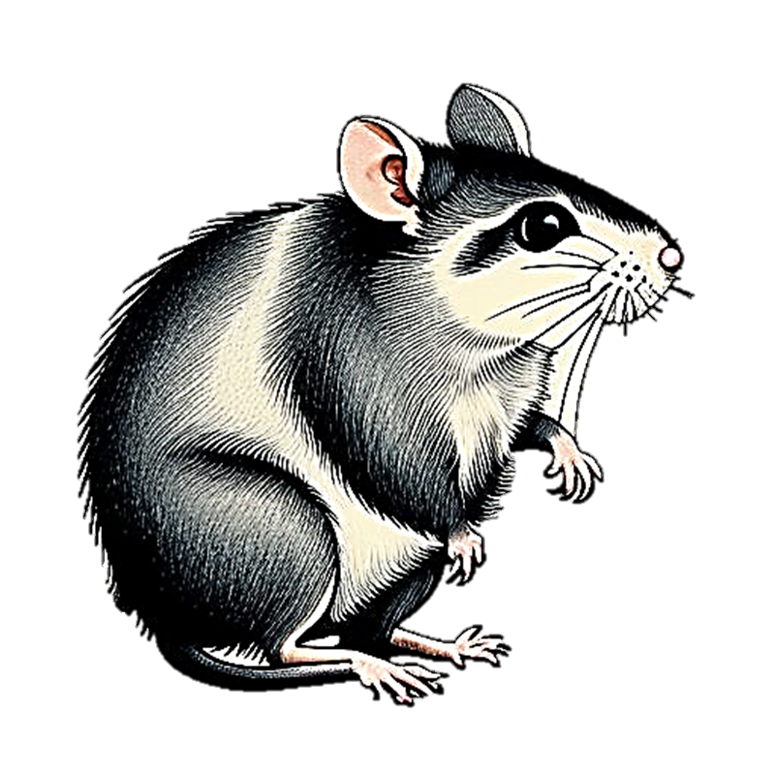
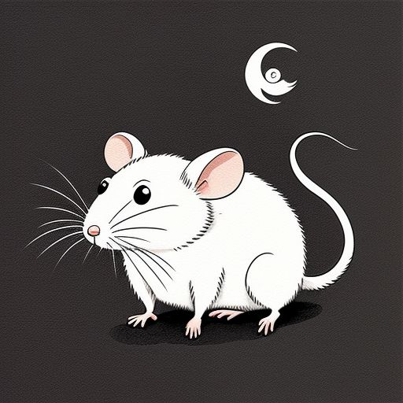
Vowel-Consonant
Blossomings.github.io
B
R
Color Splash
A
a
B
b
C
c
D
d
E
e
F
f
G
g
H
h
I
i
J
j
K
k
L
l
M
m
N
n
O
o
P
p
Q
q
R
r
S
s
T
t
U
u
V
v
W
w
X
x
Y
y
Z
z

Slide 6
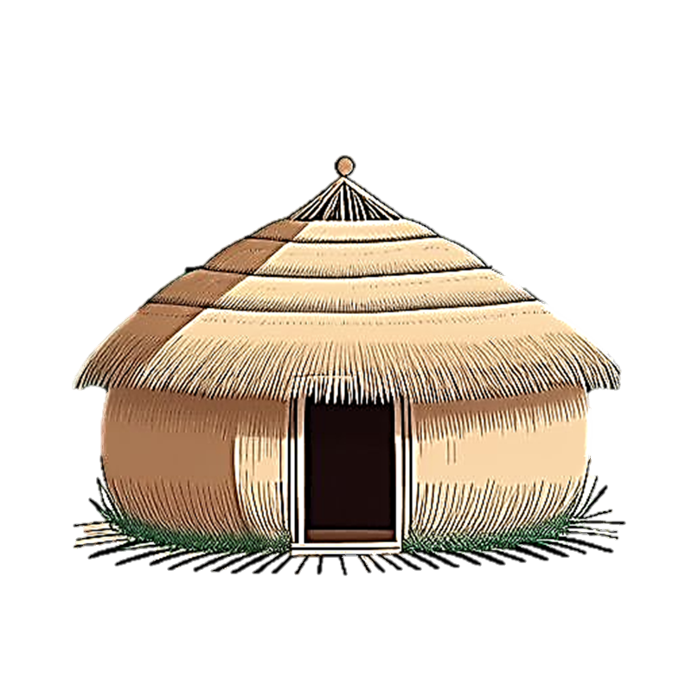
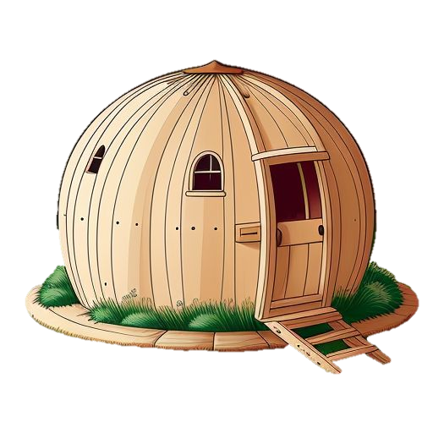
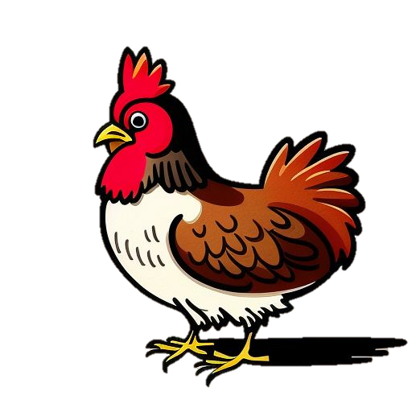
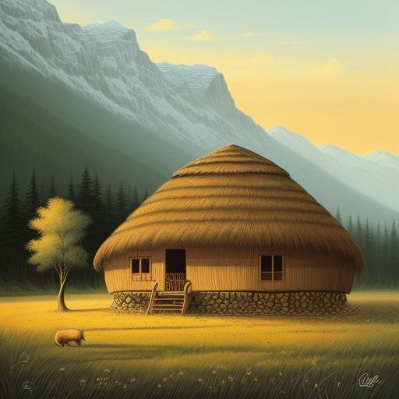
Vowel-Consonant
Blossomings.github.io
H
H
Color Splash
A
a
B
b
C
c
D
d
E
e
F
f
G
g
H
h
I
i
J
j
K
k
L
l
M
m
N
n
O
o
P
p
Q
q
R
r
S
s
T
t
U
u
V
v
W
w
X
x
Y
y
Z
z

Slide 7


Vowel-Consonant
Blossomings.github.io
H
C
Color Splash
A
a
B
b
C
c
D
d
E
e
F
f
G
g
H
h
I
i
J
j
K
k
L
l
M
m
N
n
O
o
P
p
Q
q
R
r
S
s
T
t
U
u
V
v
W
w
X
x
Y
y
Z
z

Slide 8
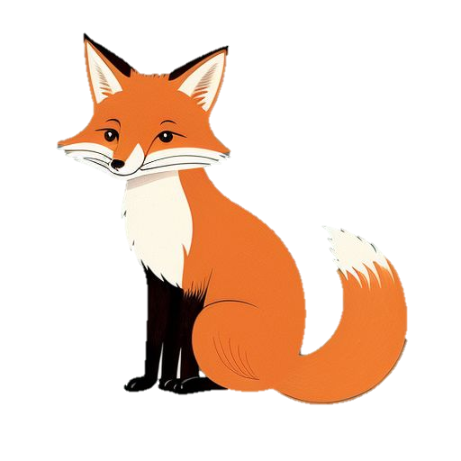

Vowel-Consonant
Blossomings.github.io
F
V
Color Splash
A
a
B
b
C
c
D
d
E
e
F
f
G
g
H
h
I
i
J
j
K
k
L
l
M
m
N
n
O
o
P
p
Q
q
R
r
S
s
T
t
U
u
V
v
W
w
X
x
Y
y
Z
z

Slide 9

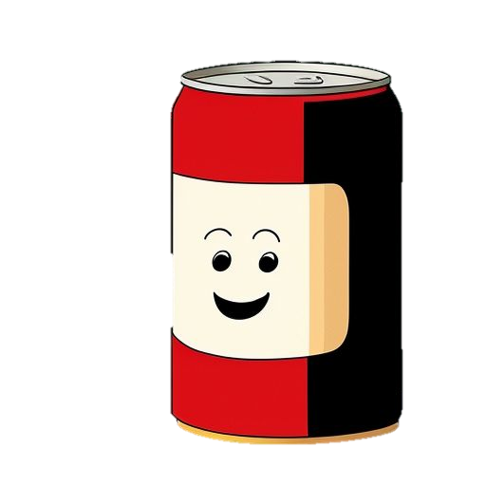
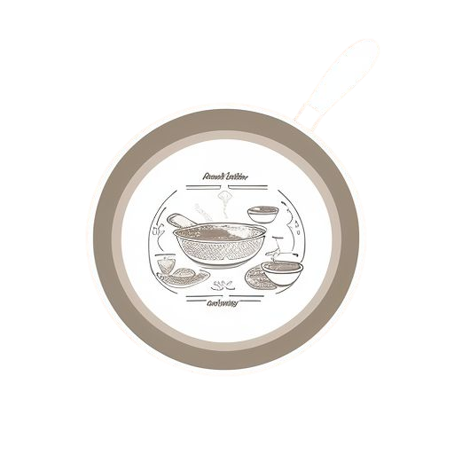
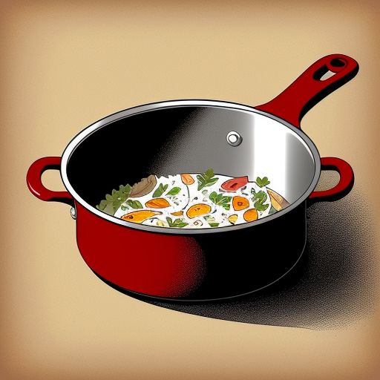
Vowel-Consonant
Blossomings.github.io
C
P
Color Splash
A
a
B
b
C
c
D
d
E
e
F
f
G
g
H
h
I
i
J
j
K
k
L
l
M
m
N
n
O
o
P
p
Q
q
R
r
S
s
T
t
U
u
V
v
W
w
X
x
Y
y
Z
z

